Slide 1
Workshop der Helmtauchgruppe vom 04.05.-06.05.2018 in Koblenz
Ulf Barthel ;Josef Helpenstein

Slide 2
Problemstellung
Die HTG möchte auf öffentlichen Veranstaltungen wie z.B. Museums- oder Hafenfeste Helmtauchgeräte vorstellen und betauchen.
Dabei soll es auch möglich sein, dass mit dieser Technik Personen tauchen, die nicht dem Verein angehören und auch nicht zwingend befähigt sind.

Slide 3
Um diese Vorhaben versicherbar
zu gestalten, müssen sie nach vorher festgelegten Verfahren (Betriebsvorschrift) ablaufen.
Dieses hat auf der Grundlage von Gefährdungsbeurteilungen (allgemein und speziell) zu geschehen.

Slide 4
Zur Beschreibung und vor allem auch zum Training der Verfahren haben wir uns in 2017 erstmalig zu einem derartigen Workshop getroffen.
Hier ging es vorrangig um die Festlegung der Erforderlichen Funktionen und der Beschreibung der Handlungsabläufe bei
Tauchgängen von unkundigen Dritten.
Notes:
After the 2nd world war 1946 resumtion of the activity on account of the approval by the allied controlling advice.
In 1951 the German Institute for Standardization became a member of the International Organisation for Standardization (ISO).

Slide 5
Rahmenbedingungen:
Taucher ohne nennenswerte Sachkunde
„Nur“ Aufenthalt unter Wasser
Vorerst keine Betrachtung von Störungen
Tauchtiefe begrenzt auf max. 5 m
Notes:
Since 1961 the German Institute for Standardization is a member in the European Committee for Standardization (CEN).
In May, 1975 the name changed in German Institute for Standardization Inc. (DINe.V.)
Since then the name of the working results occurs as a „German Norm“ or „DIN-Standard“

Slide 6
Funktionen hierzu:
Taucheinsatzführer
Signalmann
Sicherheitstaucher
Mind. 2 Taucherhelfer
Notes:
In the GDR the counterpart of the DIN-Standard were the „Technical Norms, Quality Regulations and Terms of Delivery (TGL)“ which were based in the beginning of DIN-Standards. Later more increasingly the COMECON standards (advice for mutual economic aid).

Slide 7
Zielsetzung für 2018
Der „Nur“ Aufenthalt unter Wasser wird für den Taucher kleinere Aufgaben erweitert.
Dabei muss über veränderte Gefährdungen nachgedacht werden.
Der Notfall hält Einzug, d.h. es soll ein Notfallkonzept erstellt und erprobt bzw. trainiert werden!
Notes:
In the GDR the Office for Standardization, Measuring, Being and Goods check (ASMW) was resposible.
With resolution of the ASMW in 1990 the German Institut for Standardization (DINe.V.) became responsible for the standardization in united Germany again.

Slide 8
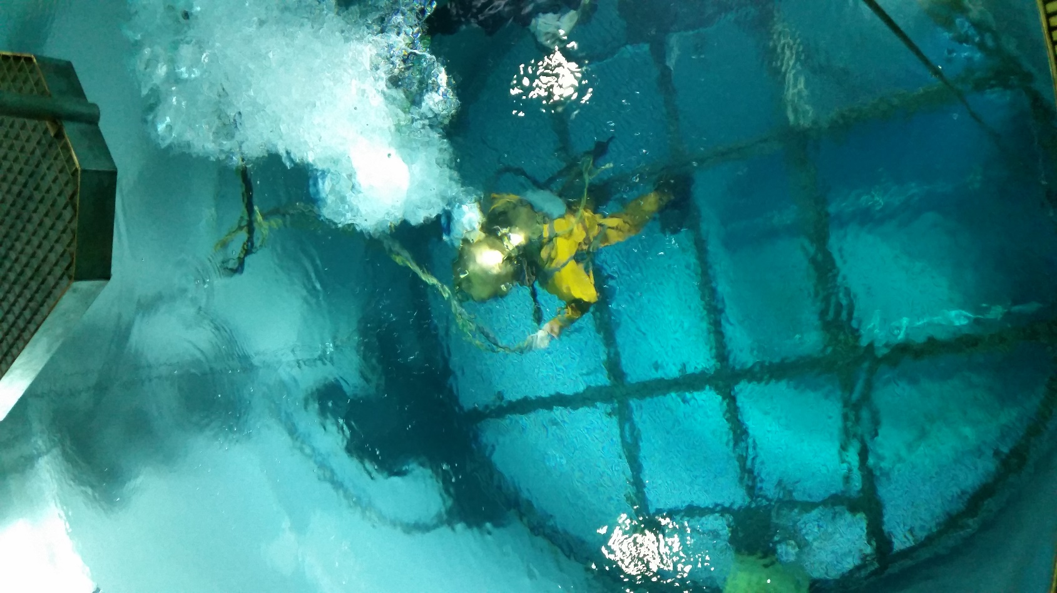
Tauchturm LFKS
Notes:
In the GDR the Office for Standardization, Measuring, Being and Goods check (ASMW) was resposible.
With resolution of the ASMW in 1990 the German Institut for Standardization (DINe.V.) became responsible for the standardization in united Germany again.

Slide 9
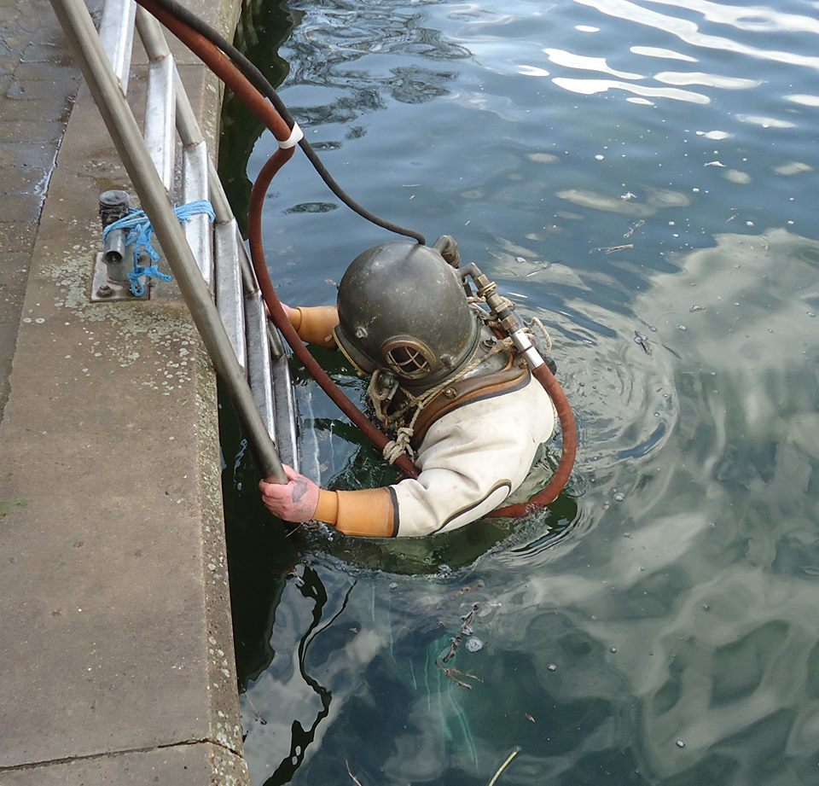
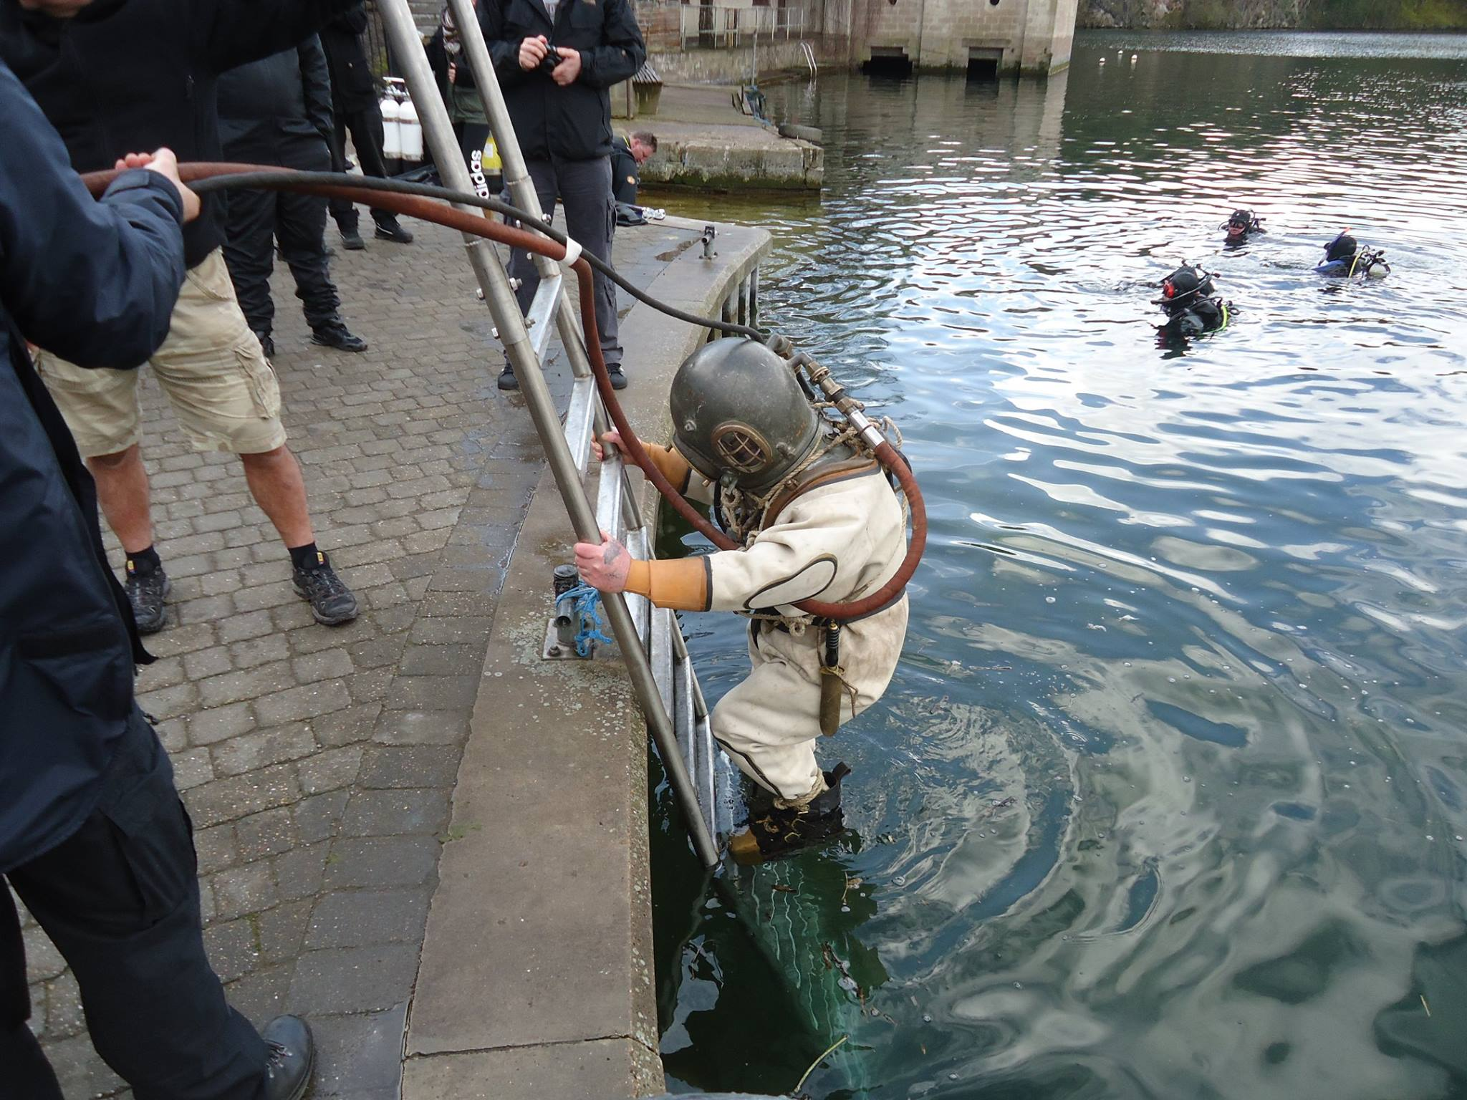
Normalfall
Quelle Übersetzung: Pons-online-Textübersetzung

Slide 10
Zielsetzung:
Notes:
Invitation for the first meeting of the new committee „Equipment for swimming divers“
In 1973 the DIN got knowledge about a working itom for Diving Apparatures for the technical Committee ISO TC 83 (Sporting and Leisure Equipment).
The strategy was to finish a German standard before ISO started working at this itom, because the starting point with a final paper would be better for each discussion.
So the corresponding Germann working group foundet a new group, called „Ausrüstung für Schwimmtaucher“. The objective was, to describe the complete Diving equipment for „Swimming Diver“. All kind of Diving (professional and leisure) should be included.

Slide 11
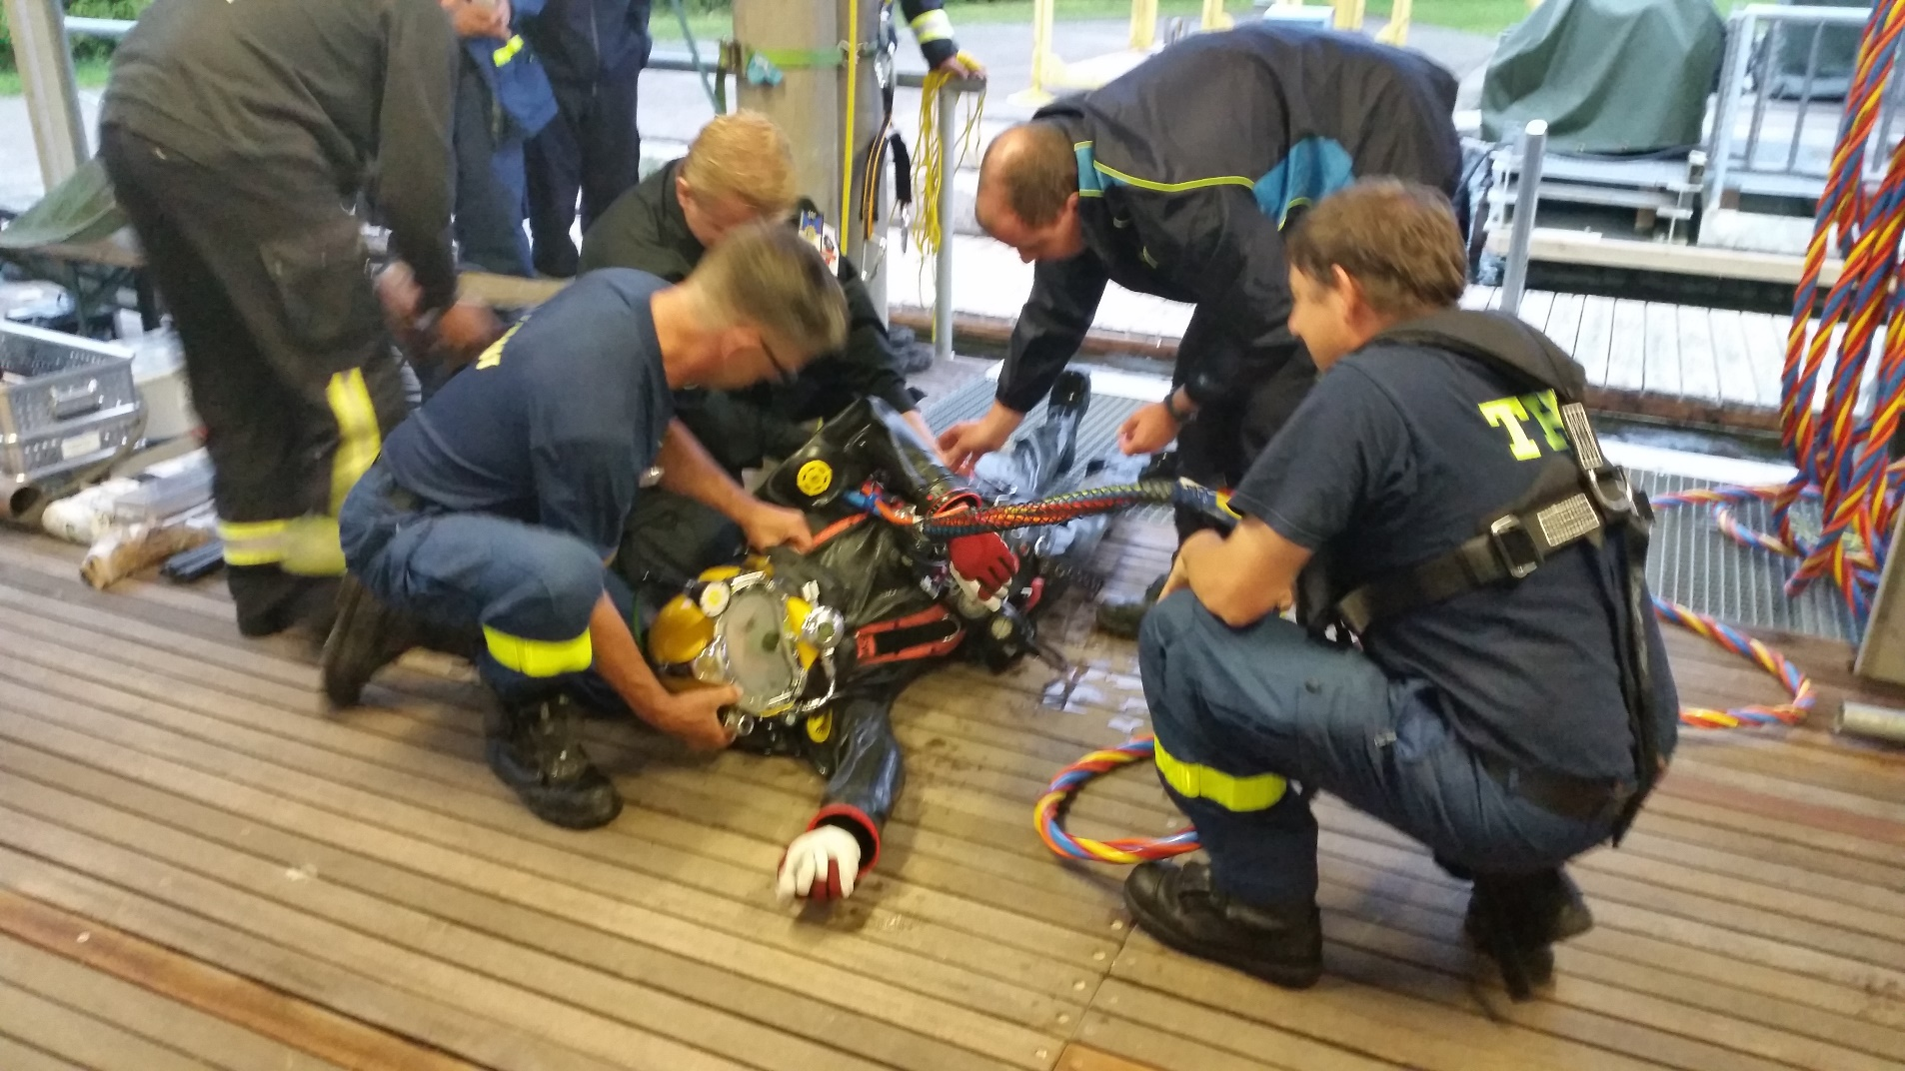
Notes:
During the first meeting there were a lot of dicussions about the memberchip in DIN-Groups. Corresponding to the DIN-rules the members of the working groups hat to pay for the service and secretariat of the German Institut for Standardization. That was finally only possible for the members of the professionale scene, the manufactorers and the autorities. The Organisations and Assosiations of the leisure divers were not able to do that.
Finaly this is the reason for the problems we have until now. The equipment for professionals is different to the equipment for leisure diving because the professionals have to be close to their safety regulations. So the first German standards for diving were createt, pimarily, on account of this consideration.

Slide 12
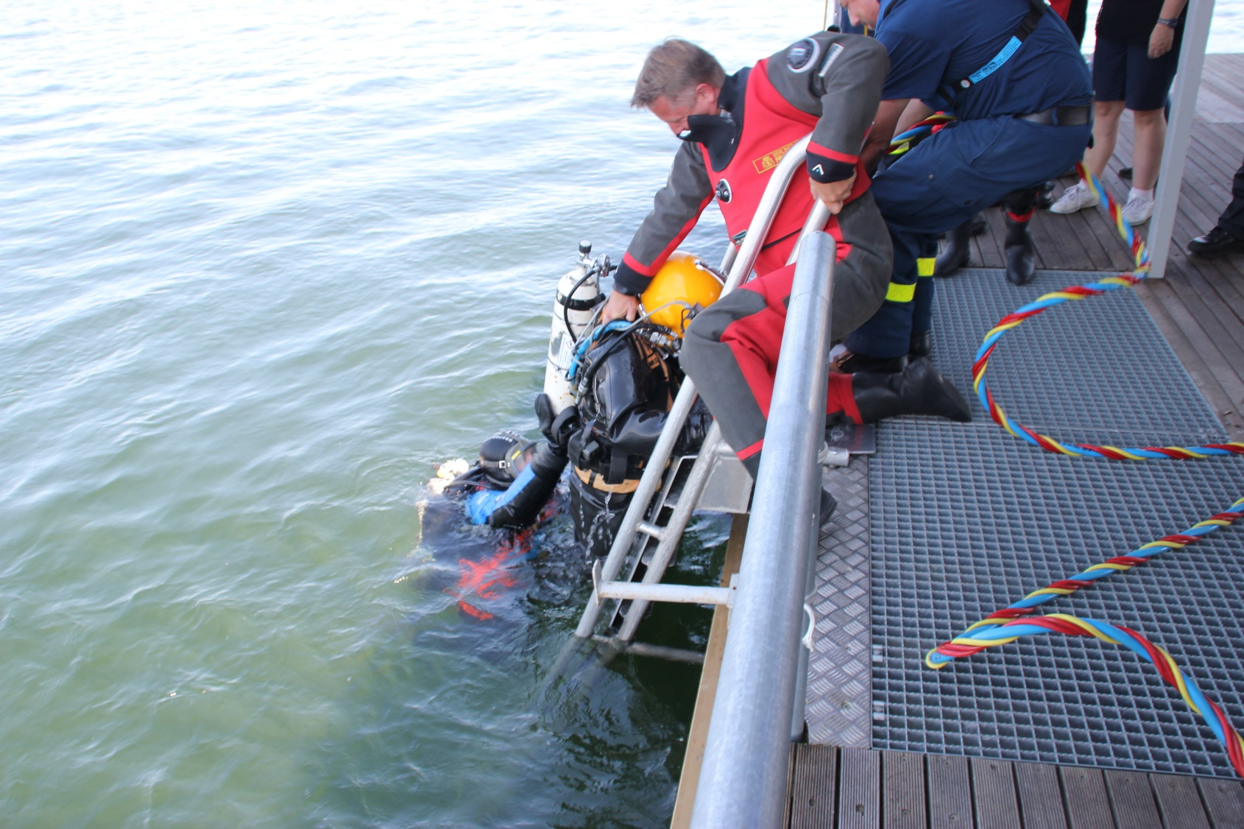
Notes:
The collection about existing german standards and sets of rules for the first Meeting in 1973.

Slide 13
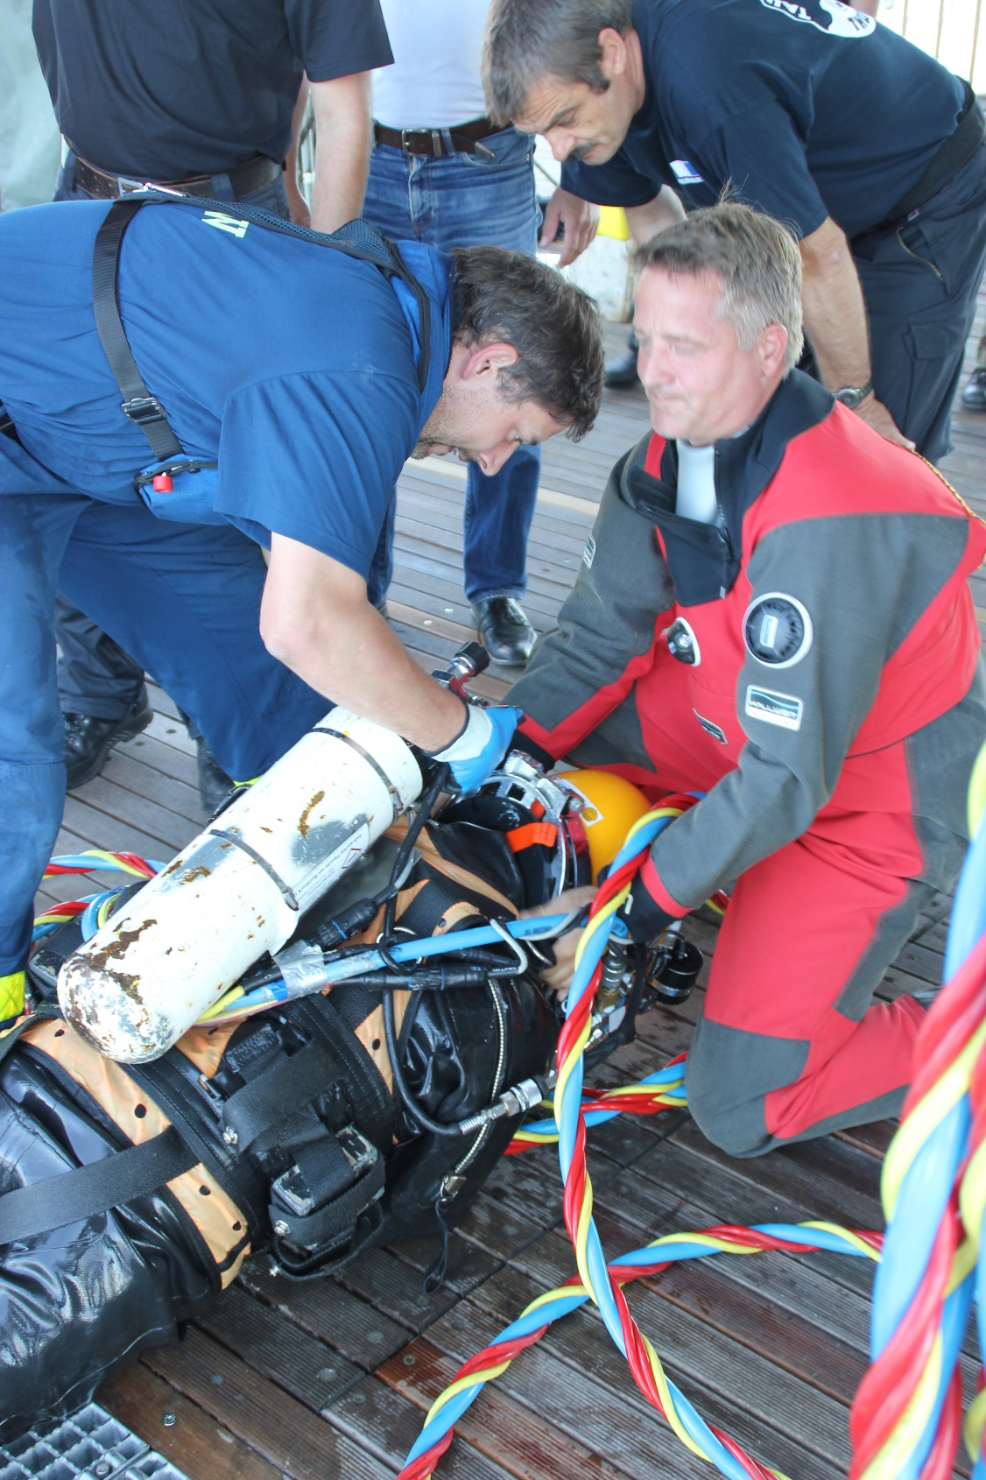
Notes:
The collection about existing german standards and sets of rules for the first Meeting in 1973.

Slide 14
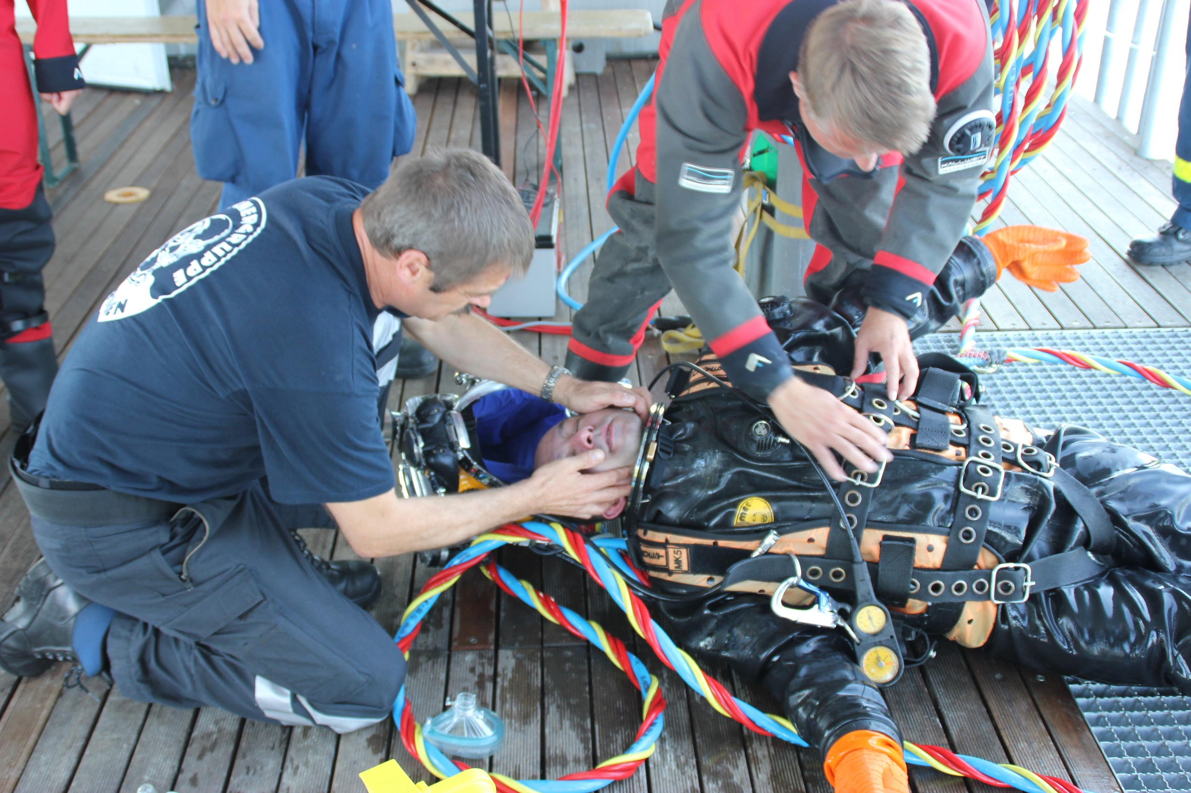
Notes:
The collection about existing german standards and sets of rules for the first Meeting in 1973.

Slide 15
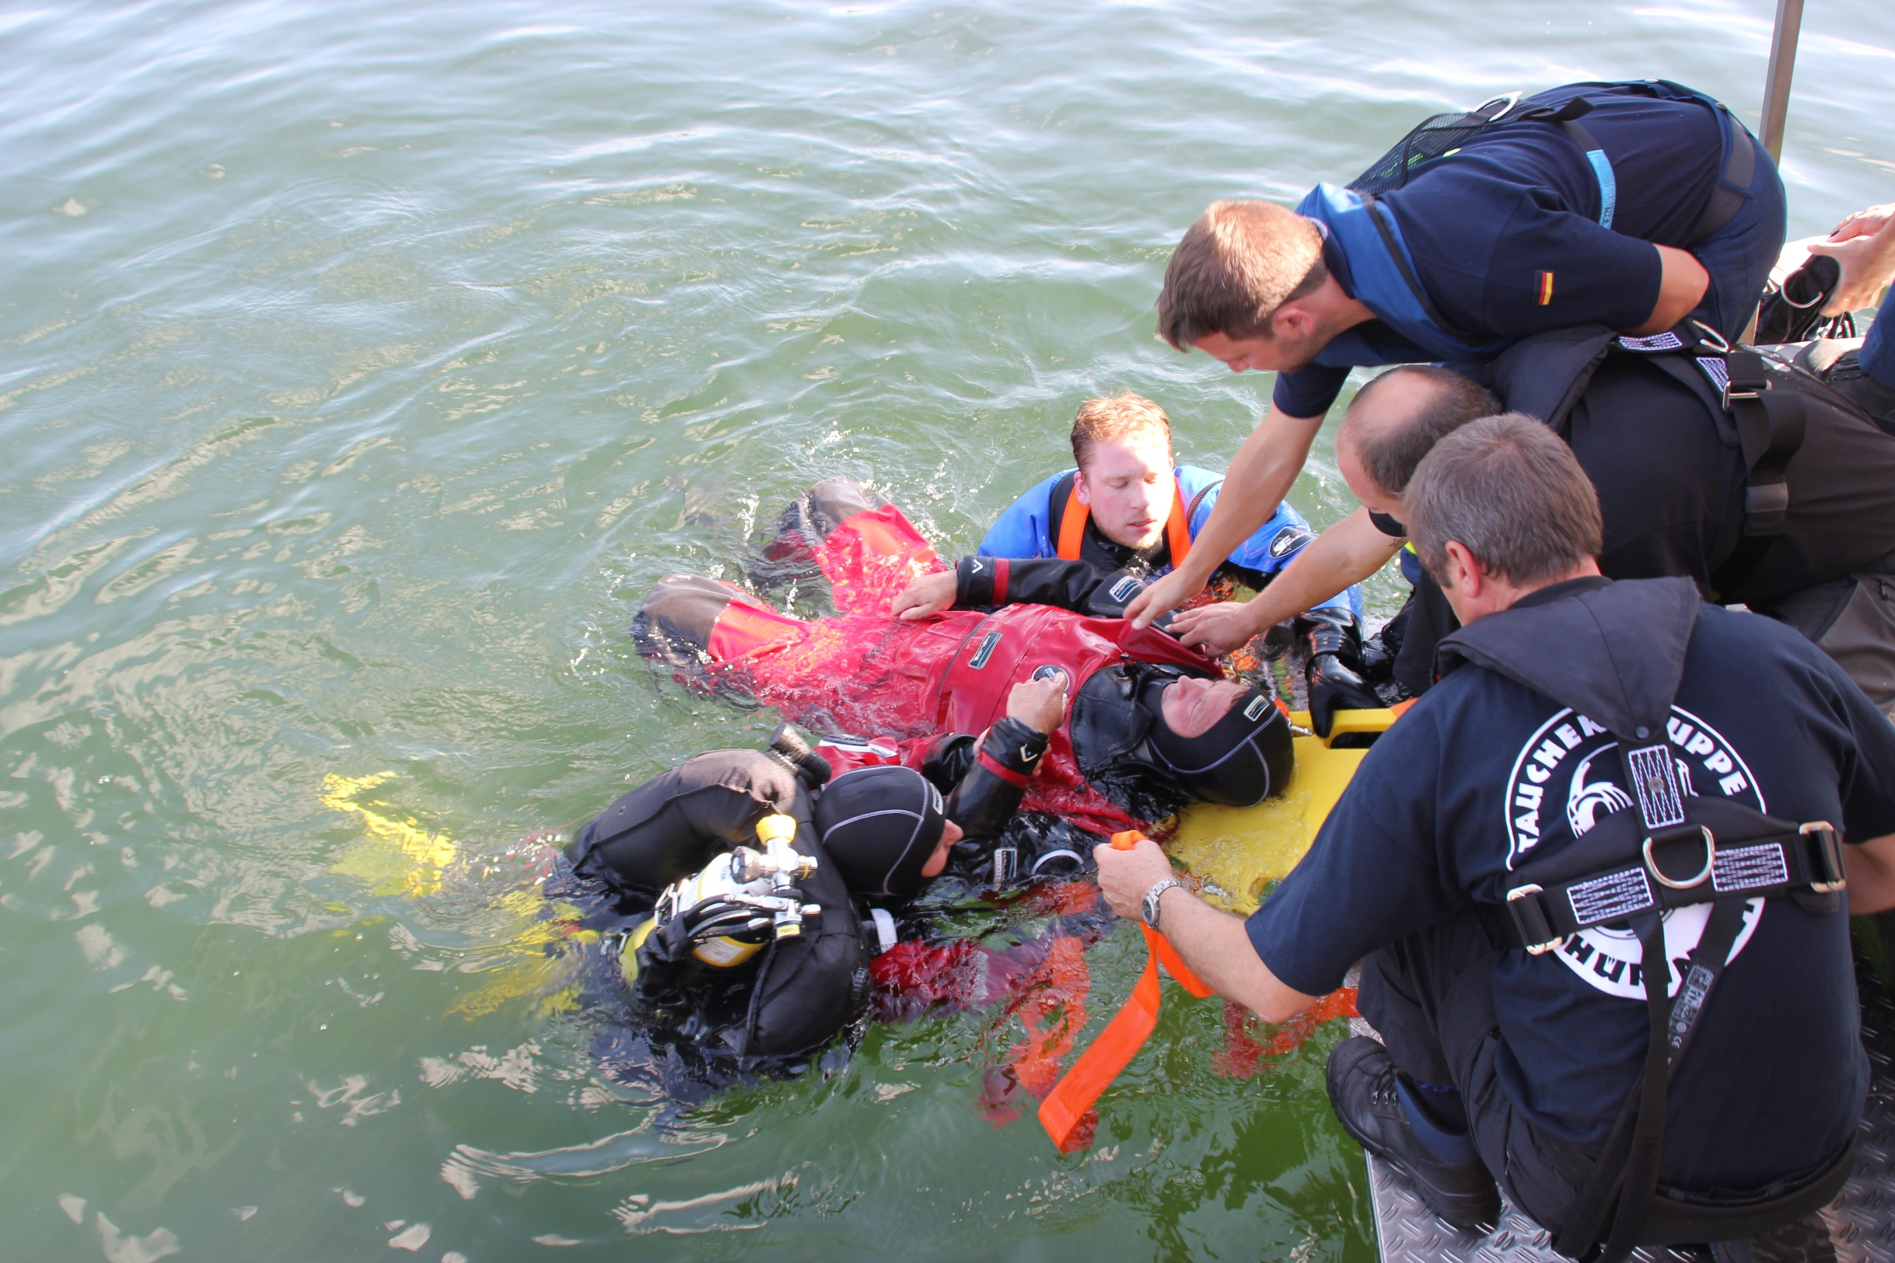
Notes:
The collection about existing german standards and sets of rules for the first Meeting in 1973.

Slide 16
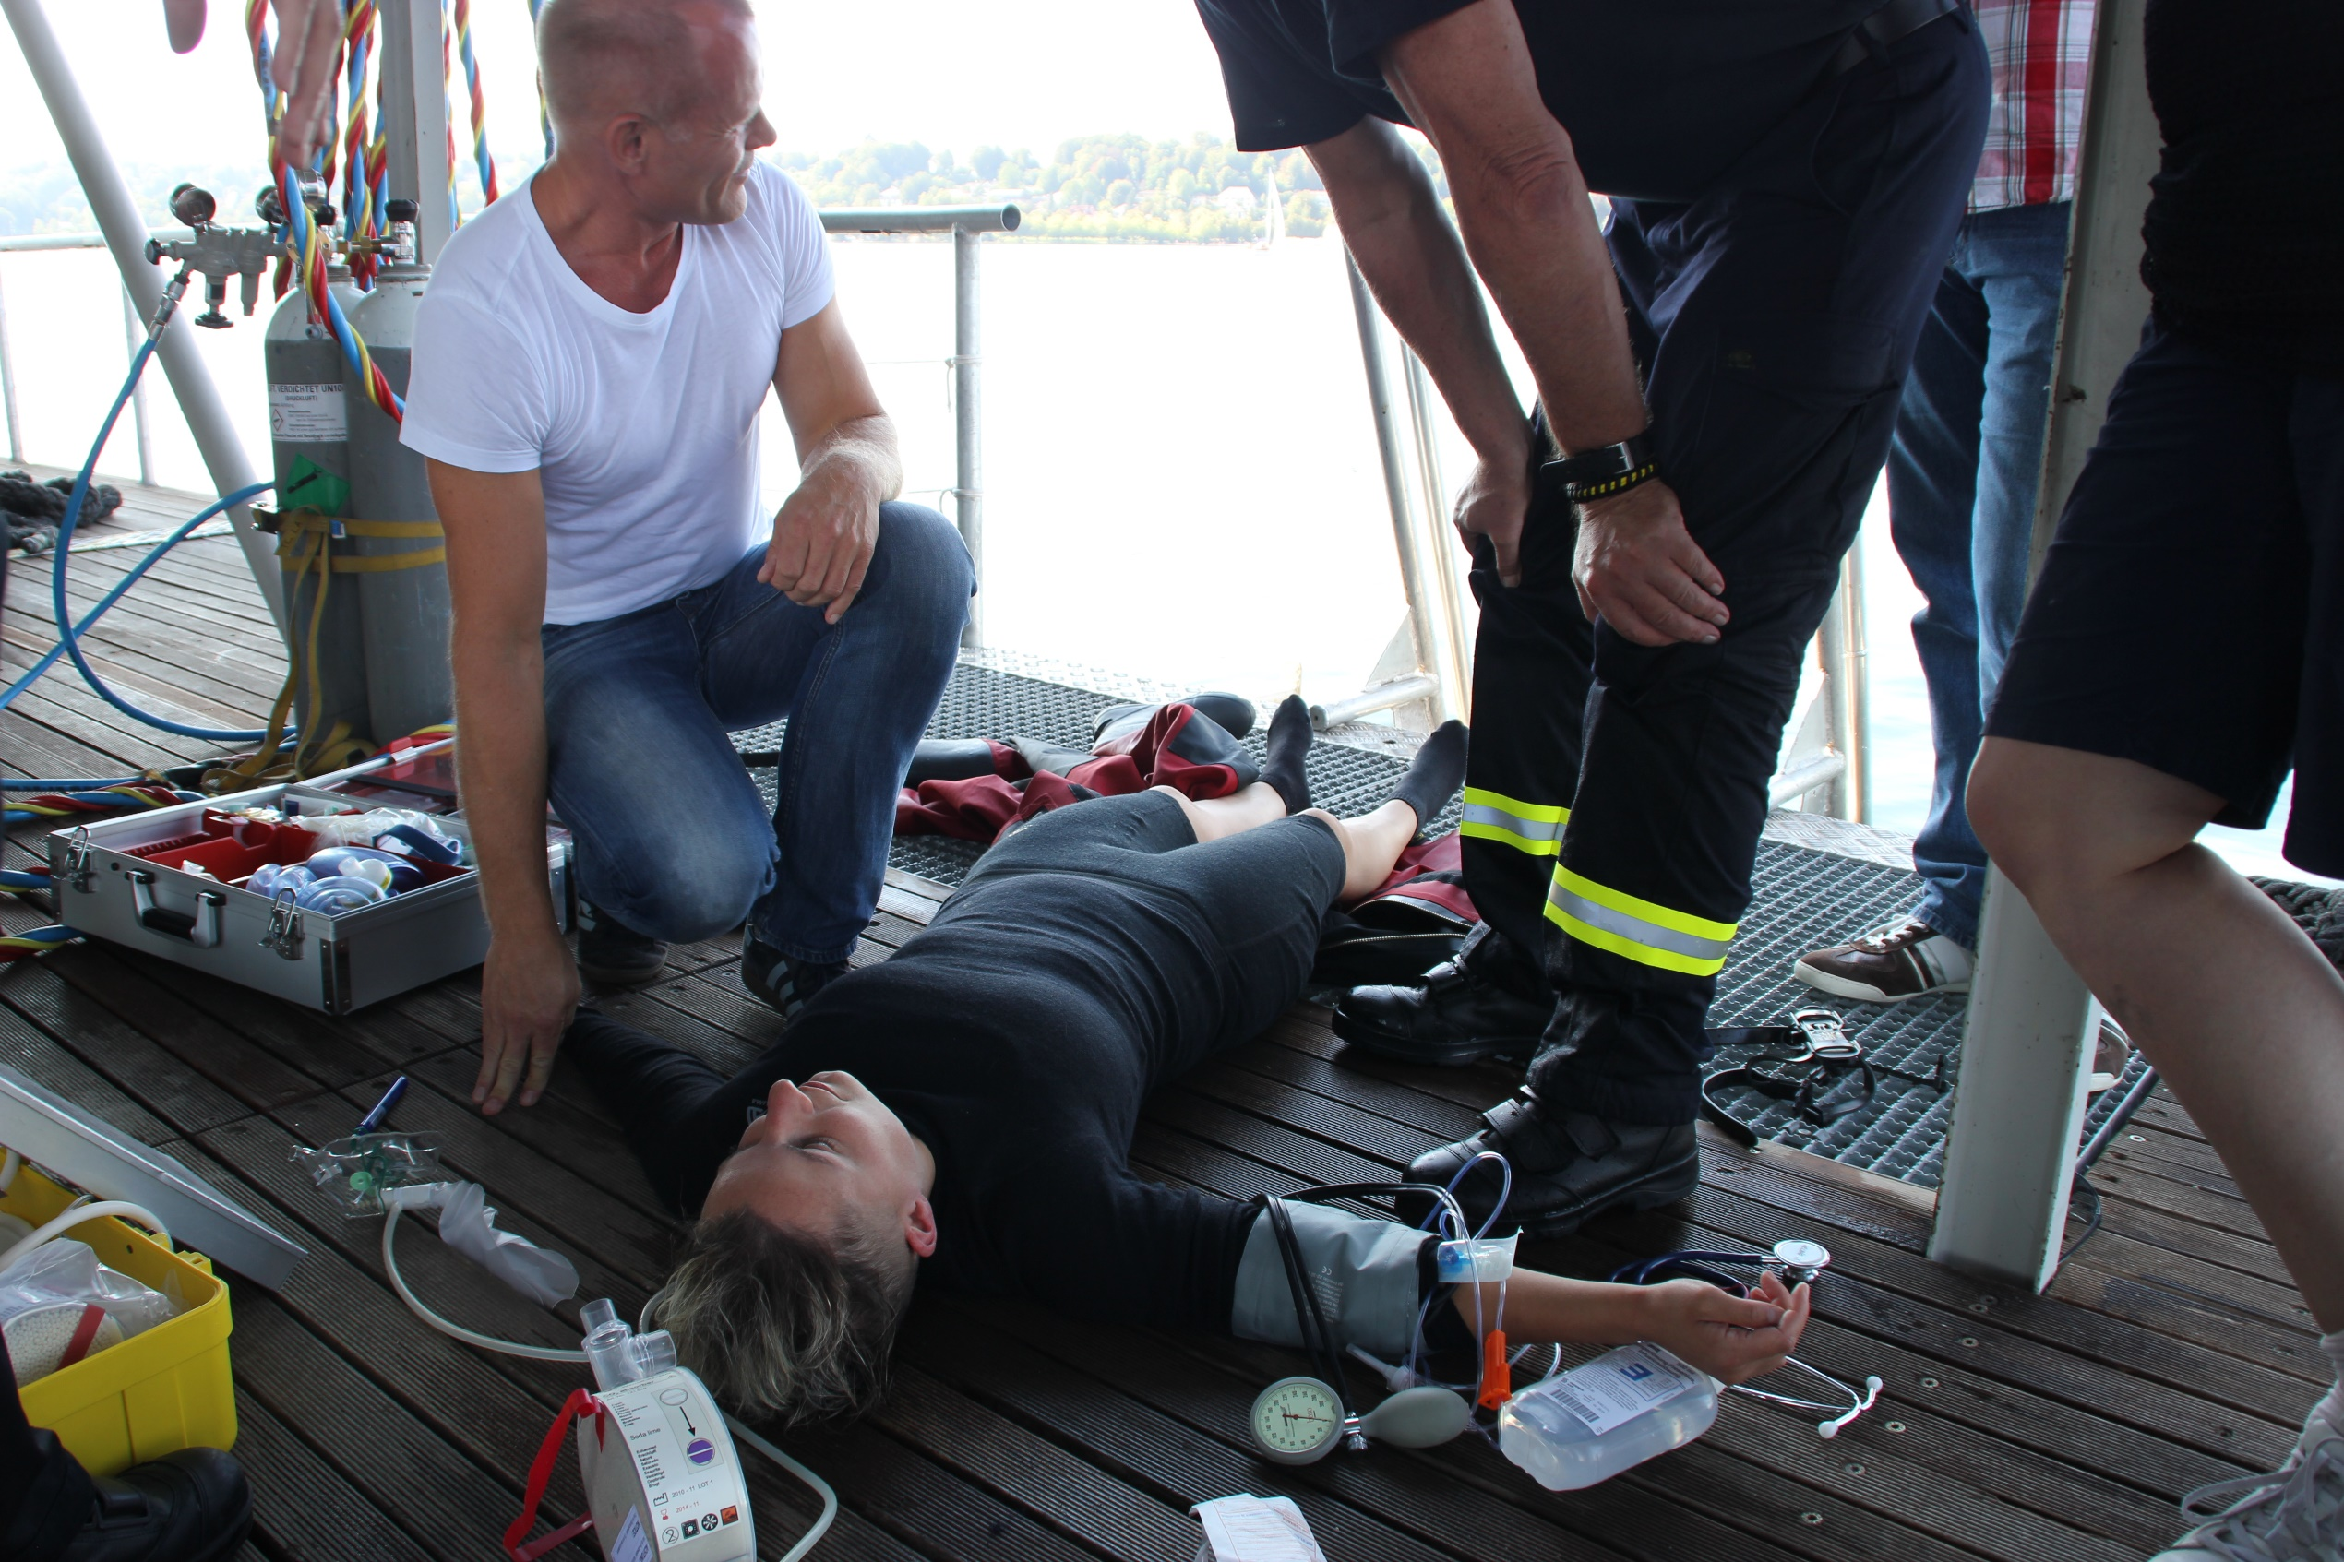
Notes:
The collection about existing german standards and sets of rules for the first Meeting in 1973.

Slide 17
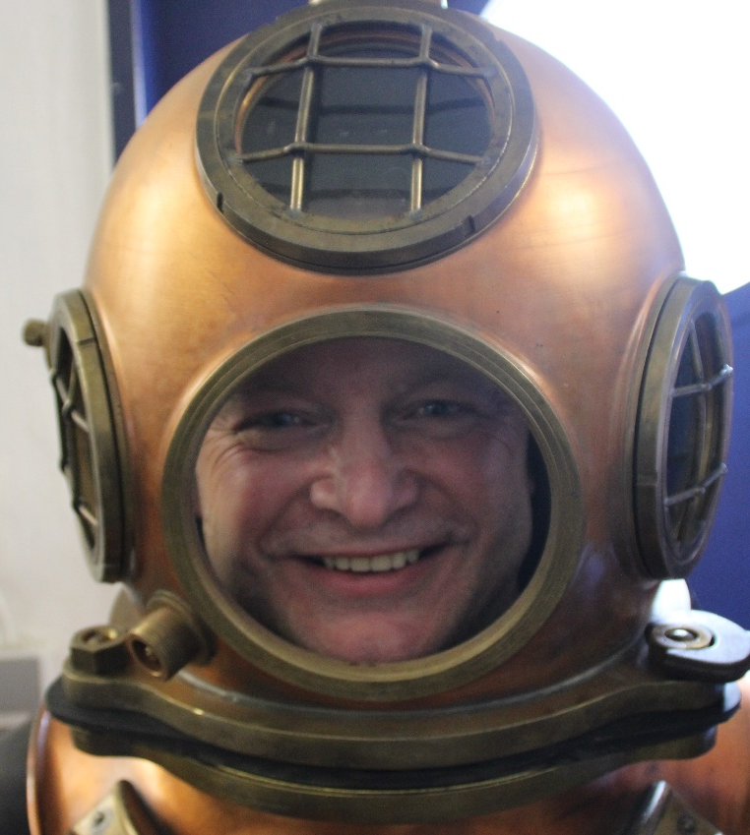
Danke für Ihre Aufmerksamkeit!
Thanks for Your attention!
Fragen, Anmerkungen ?
Questions,
Remarks ?

